Slide 1

MILKYWAY INSIGHTS
Presentation By
Sonal Prashant Raikar
Roll no : DS22F3002469

Slide 2
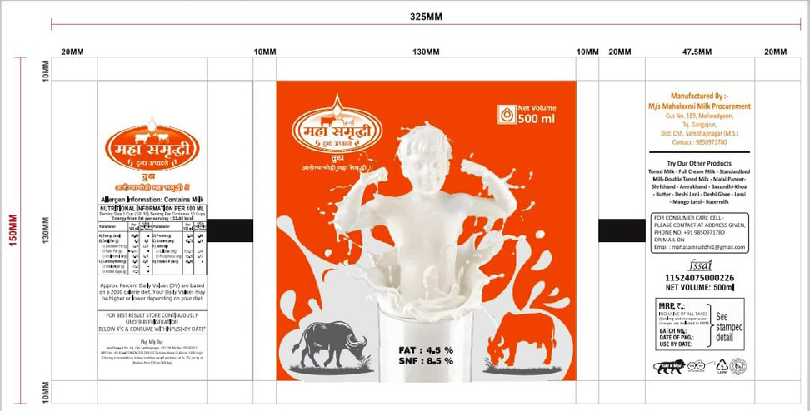
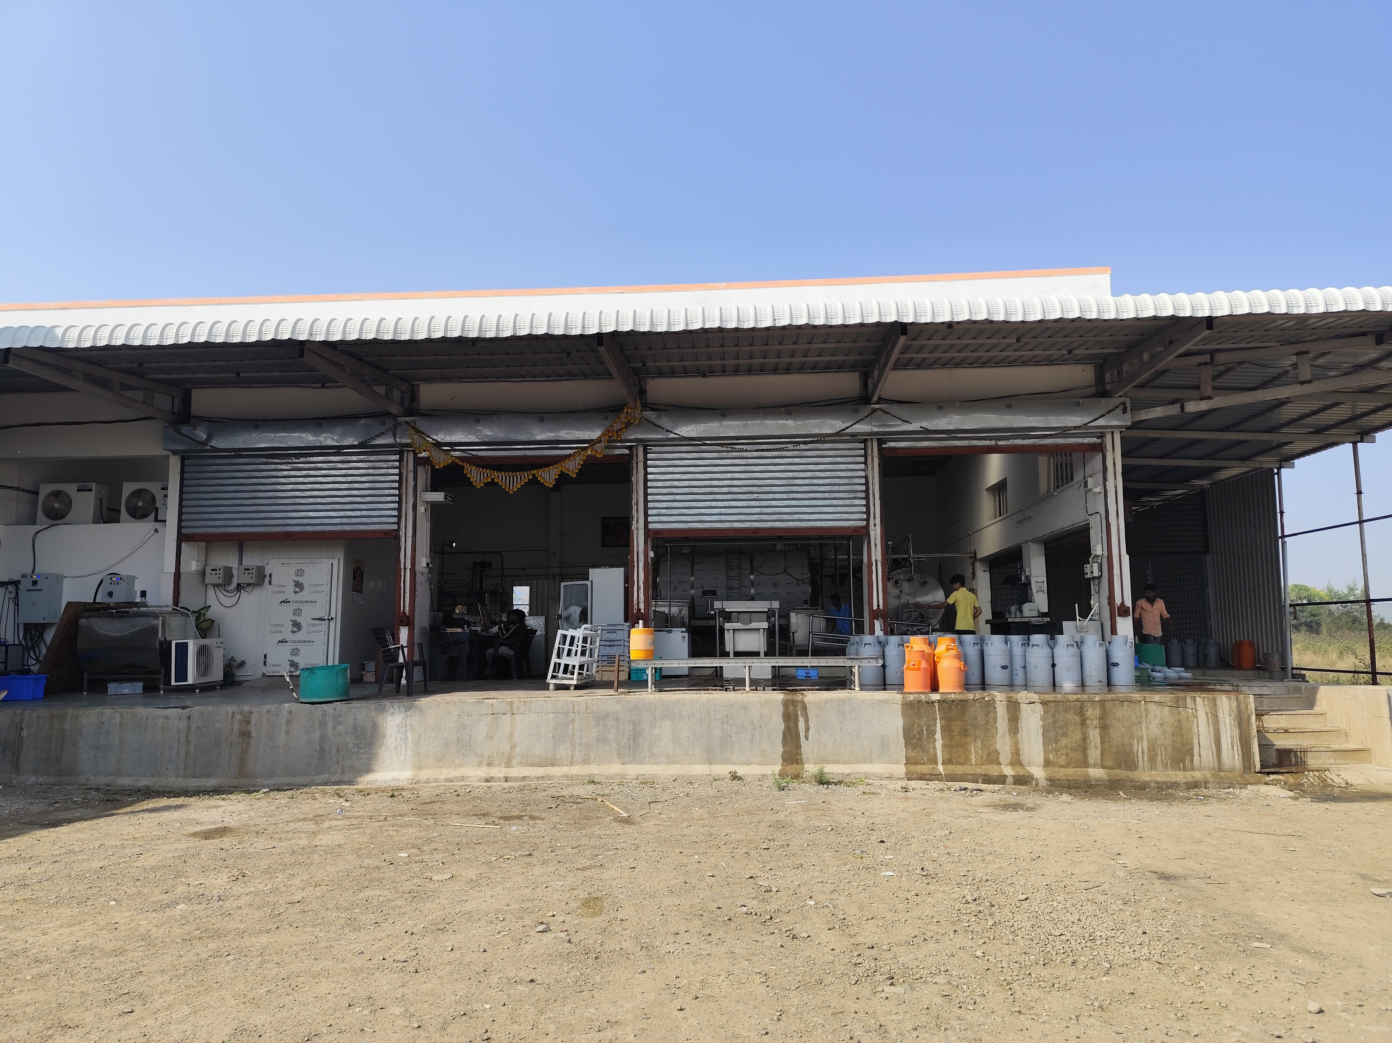
ABOUT THE PROJECT
Founded: 2024
About the company :
The company was found with intention to provide good quality of milk and milk products to people.
located at Maliwadgaon, Taluka Gangapur, District Aurangabad (Chh Sambhajinagar), Maharashtra.
Established For:
The factory named Mahalakshmi Milk procurement was chosen for the purpose of data analysis and a data of 8 months was collected. .
Objective of the project:
Objective of the project was to identify the business problems and find a way out to solve those problems to help the shop owner run the business in a better way.

Slide 3

PROBLEM STATEMENTS
• Milk Procurement Challenges : Low milk collection.
• Sales Challenges : Low product sales.
• Inefficient Milk Utilization : Excess cream wastage.
• Profitability Challenges : Low profit margins.

Slide 4

Problem-Solving Approach for MilkyWay Insights :
Problem Identification
Milk Procurement, Sales, Utilization, and Profitability Challenges.
Data Collection and Understanding
Factory data, surveys, market research, and case studies.
Data Cleaning and Preparation
Cleaned, validated, and visualized data using Excel.
Analysis and Diagnosis
Descriptive, Diagnostic, Predictive, and Prescriptive Analysis.
Solution Formulation
BMC Implementation, Product Diversification, Seasonal Production Strategy, and Sales Optimization.
Implementation and Monitoring
Strategic execution, performance tracking, and adjustments.
Evaluation and Continuous Improvement
Assessed outcomes, ensured continuous monitoring, and recommended future growth strategies.
PROBLEM SOLVING APPROACH

Slide 5
Data Analysis
In workbook there are seven sheets as :
Collection data :
Sales data :
Descriptive Statistics :
Production data :
Collection data gives information about the amount of milk collected to the factory.
Sales data gives information about the sales done by the factory of various products produced in the factory.
This shows the Quantity of various products produced in the factory like ghee, pedha,paneer,etc.
This shows the mx, min, avg and other statistics of the data.

Slide 6


ANALYSIS PROCESS
Data Collection
Gathered factory data on milk collection, production, and sales.
Conducted market research and competitive analysis.
Data Cleaning
Cleaned and organized data using Excel for accuracy.
Removed inconsistencies and handled missing values.
Data Analysis
Descriptive Analysis: Identified trends and patterns.
Diagnostic Analysis: Found root causes of challenges.
Predictive Analysis: Forecasted demand and sales.
Prescriptive Analysis: Suggested actionable strategies.
Visualization
Created graphs and charts for clear data representation.
Recommendation Generation
Proposed solutions like BMC implementation and product diversification based on insights.

Slide 7
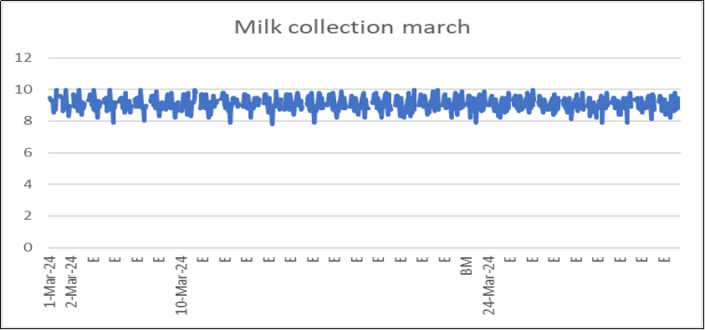
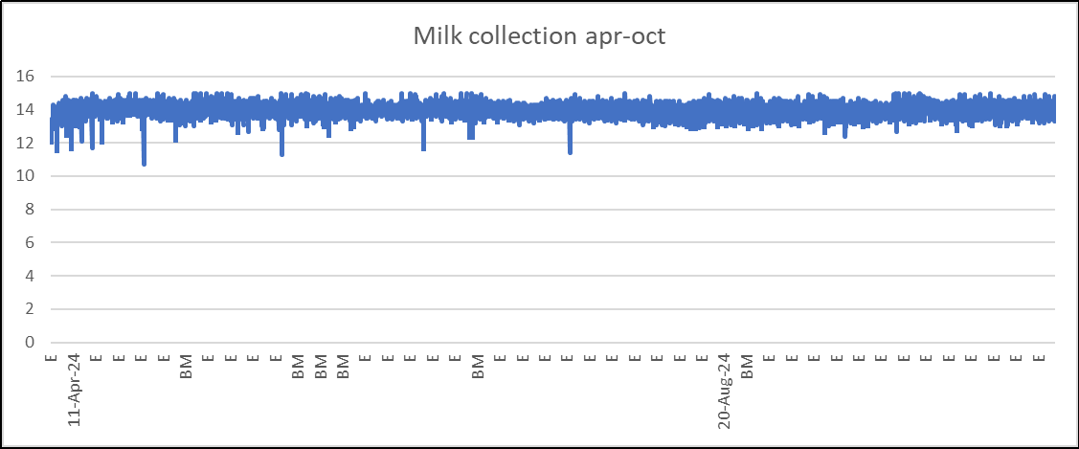
RESULTS
Increased Milk Collection
Implementation of Bulk Milk Coolers (BMCs) led to an increase in milk collection for the factory.
From the above graphs, it can be seen that the milk collection in march was 8 to 10 ltrs . But after the introduction of various BMC’S for milk collection, the milk collection raised from April to October by 11 to 15 ltrs. Hence there was an increase in milk collection due to introduction of the BMC’S.

Slide 8
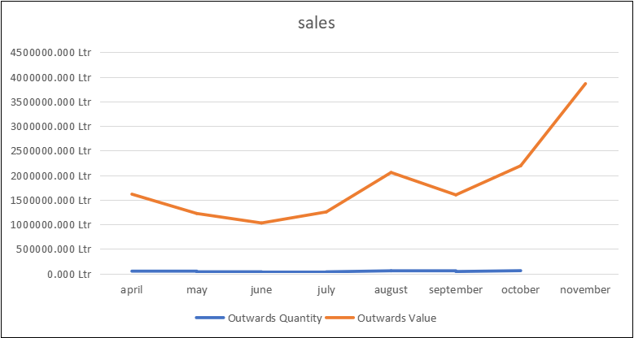
RESULTS
Improved Sales :
Seasonal production strategies boosted sales, especially during festivals.
From the above graph we can see that in April, there was no such sales of the products but when the factory produced more products while nearing festive season that is during August(Ganesh Chaturthi) and October-November (Deepawali) , the sales rised high . This led to increase in sales and profits for the company.

Slide 9
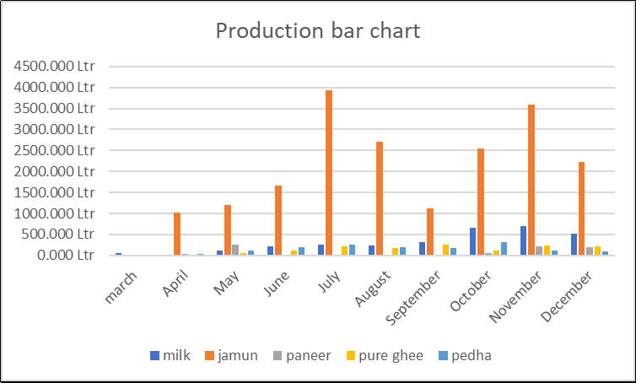
RESULTS
Efficient Milk Utilization :
Excess cream was used to produce value-added products like ghee and butter, reducing wastage.
Enhanced Profitability :
Better resource utilization and increased sales resulted in higher profits.

Slide 10
RESULTS
Enhanced Profitability :
Better resource utilization and increased sales resulted in higher profits.
From the above graph , we can see that the production of different products in the beginning near about March was very less, then after this, discussion on the SNF and making the changes, the other products came into sale and hence made a proper and efficient way to use the milk. Thereby solving the problem of Inefficient Milk Utilization and enhancing sales and profitabolity.

Slide 11





RECOMMENDATIONS
Expand BMC Network
Set up additional BMCs in nearby regions to further increase milk collection.
Product Diversification
Develop more value-added products using excess cream to maximize revenue.
Seasonal Production Strategy
Continue increasing production of high-demand products like khoya and pedha during festivals.

Slide 12



RECOMMENDATIONS
Sales Optimization
Implement targeted marketing campaigns and promotional offers during peak seasons.
Continuous Monitoring
Regularly analyze sales and production data to adjust strategies for sustained growth.

Slide 13

THANK
YOU

